Slide 1
Welcome to our
English class 3A7!

Slide 2
Unit 8: Food
Lesson 2.1
Page 113
A
Warm-up
Wrap-up
Vocabulary
B
C
Structure
Wrap-up
D
E
Homework

Slide 3
Warm-up

Slide 4

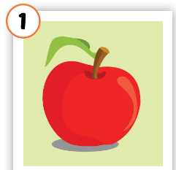
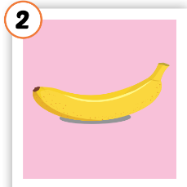
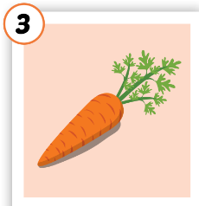
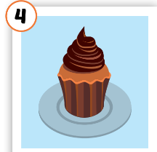
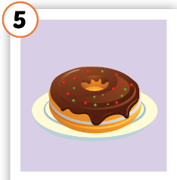





Review
/ˈæpl/
quả táo
/bəˈnænə/
quả chuối
/ˈkærət/
củ cà rốt
/ˈkʌpkeɪk/
bánh cốc
/ˈdəʊnʌt/
bánh vòng

Slide 5
Guessing game!

Slide 6

It’s time to learn …

Slide 7
Vocabulary

Slide 8
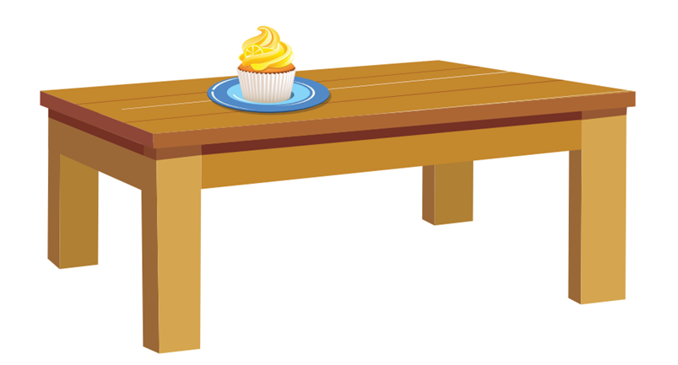
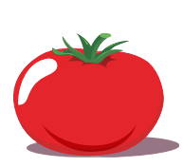
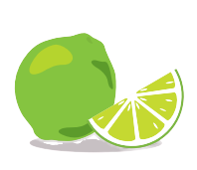
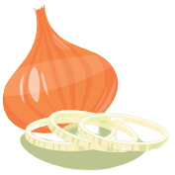
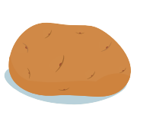
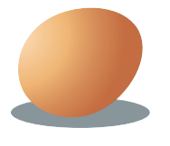

What can you see on the table?

Slide 9


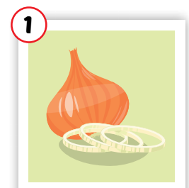
onion
/ˈʌnjən/
củ hành tây

Slide 10
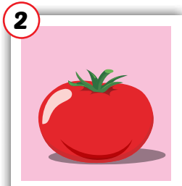
tomato
/təˈmeɪtəʊ/
cà chua

Slide 11
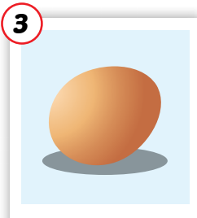
egg
/eɡ/
trứng

Slide 12
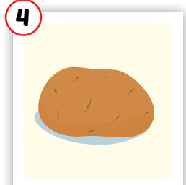
potato
/pəˈteɪtəʊ/
khoai tây

Slide 13
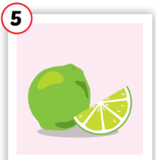
lime
/laɪm/
quả chanh(xanh)

Slide 14
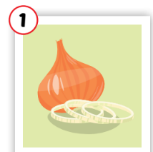


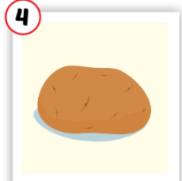
onion
tomato
egg
potato
lime
/ˈʌnjən/
củ hành tây
/təˈmeɪtəʊ/
cà chua
/laɪm/
quả chanh(xanh)
/eɡ/
trứng
/pəˈteɪtəʊ/
khoai tây

Slide 15

Practice

Slide 16


Listen and choose the correct picture
Sound here
Click each number to check the answer.
1
2
3
4
5

Slide 17
Listen and choose the correct picture
Click each number to check the answer.
Sound here
1
2
3
4
5

Slide 18
Listen and choose the correct picture
Sound here
Click each number to check the answer.
1
2
3
4
5

Slide 19
Listen and choose the correct picture
Sound here
Click each number to check the answer.
1
2
3
4
5

Slide 20
Listen and choose the correct picture
Click each number to check the answer.
Sound here
1
5
2
3
4

Slide 21
Structures

Slide 22
Structures
Are there any…?
- Yes, there are (some…)/ No, there aren’t.
Is there…?
Yes, there is (a/an…)
No, there isn’t.

Slide 23



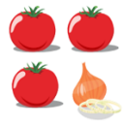
Click on each sentence to listen
- Yes, there are
- No, there aren’t.
Are there any tomatoes?
- Yes, there is.
- No, there isn’t.
Is there an onion?

Slide 24
Practice

Slide 25
Look at the picture and make sentences.
tomatoes
1. Are there any______________?
Yes, _____________________
there are

Slide 26
Look at the picture and make sentences.
2. Are there any_______________?
No, _____________________
potatoes
there aren’t

Slide 27
Look at the picture and make sentences.
lime
3. Is there a _________________?
No, _____________________
there isn’t

Slide 28
Look at the picture and make sentences.
onion
4. Is there an_________________?
Yes, _____________________
there is

Slide 29
Game!

Slide 30

WRAP-UP

Slide 31
Friday, April 21st 2023
Unit 8: Food
I. New words
Onion
Tomato
Egg
Potato
Lime
II. Structures
1. Are there any tomatoes?
Yes, there are (some tomatoes).
No, there aren’t.
2. Is there an egg?
Yes, there is (an egg).
No, there isn’t.

Slide 32
Thank you for your listening!

