Slide 1


Welcome to our class!

Slide 2

Unit 3: School
Lesson 4.3
Page 49

Slide 3
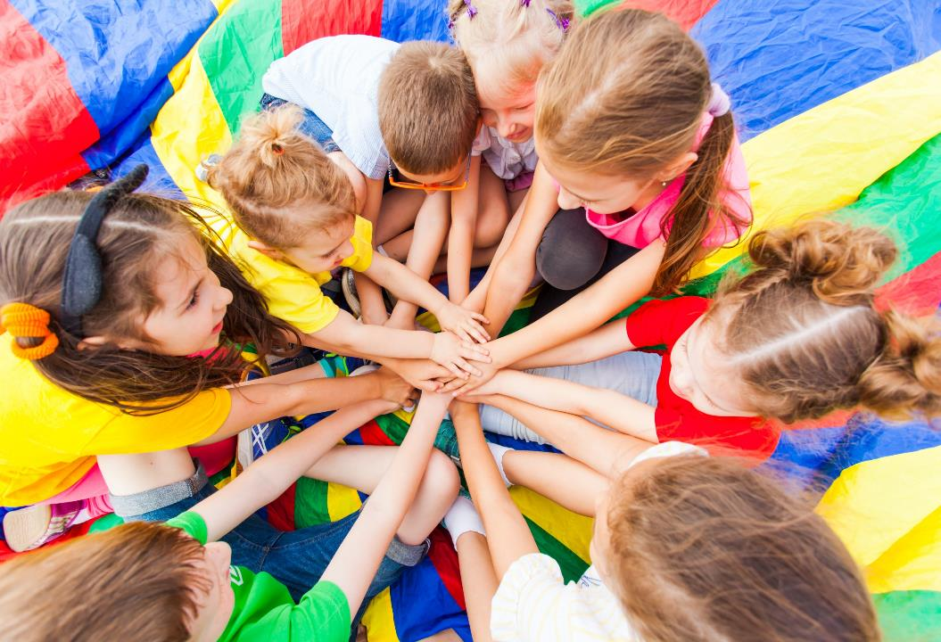
WARM UP

Slide 4

Let’s play!
Touch
Have students run around the classroom touching things in the color that the students shout out: "green".

Slide 5
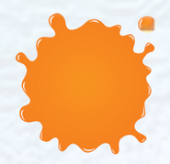
orange

Slide 6
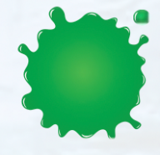
green

Slide 7

pink

Slide 8

purple

Slide 9

gray

Slide 10

black

Slide 11

It’s time to learn …

Slide 12
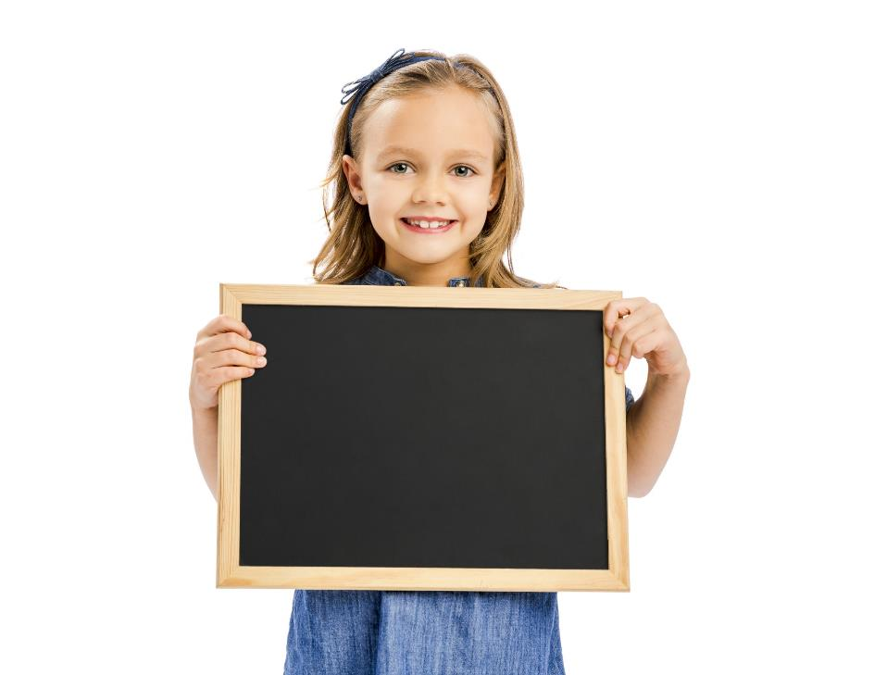
Reading

Slide 13

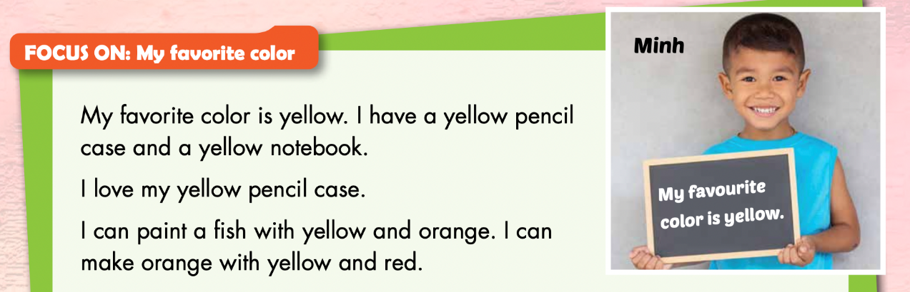
Notes:
Read the text as a whole class.
Have students read the text individually.
Play “Whisper game”
Demonstrate the activity using the example.

Slide 14
1. Minh has a blue notebook. True/ False

Slide 15
2. Minh can paint a fish. True / False

Slide 16
3. Minh can make yellow with orange and red. True / False

Slide 17

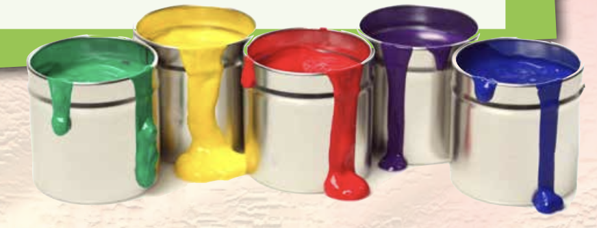
What is Minh’s favorite color?
It’s yellow.

Slide 18
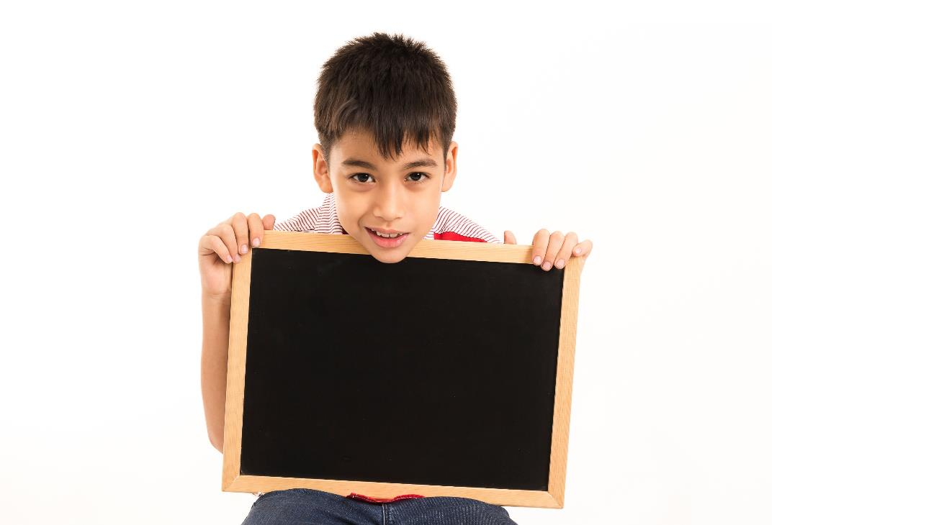
Writing

Slide 19
Have students read the text in Part E again.
Have students fill in the blanks about their favorite color.

Slide 20
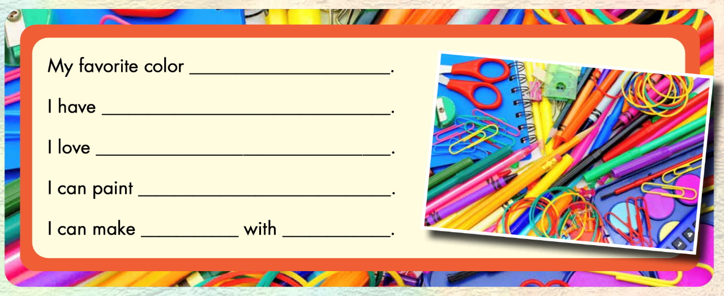
Example:
red
a red pencil
my red pencil
a pencil case
pink
red and white

Slide 21

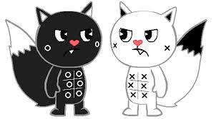
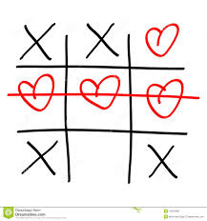
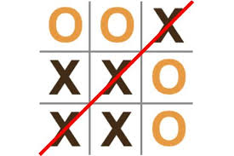
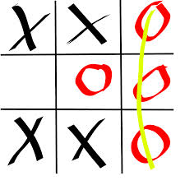

Slide 22

TEAM A
1
2
3
TEAM B
O1
X1
O2
X2
4
5
6
O3
X3
O4
X4
O5
X5
7
8
9
O6
X6
O7
X7
O8
X8
O9
X9
N1
N2
N3
D1
D2
D3
CT
CP

Slide 23

Blue
red
purple
…….and ……. make ……...
01
02
03
04
05
00

Slide 24
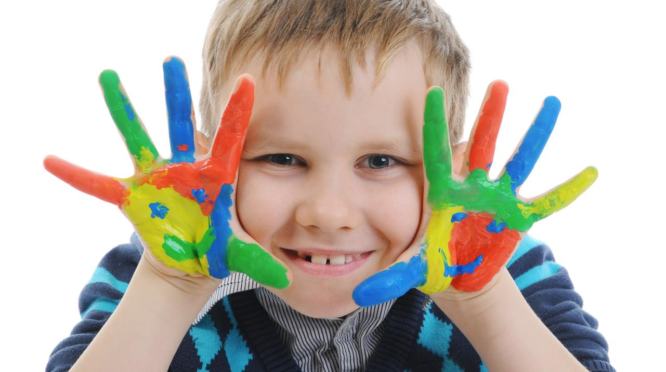
What’s your favorite color?
My favorite color is……..
01
02
03
04
05
00

Slide 25

pencil
blue
I can paint a ……… with……..
01
02
03
04
05
00

Slide 26
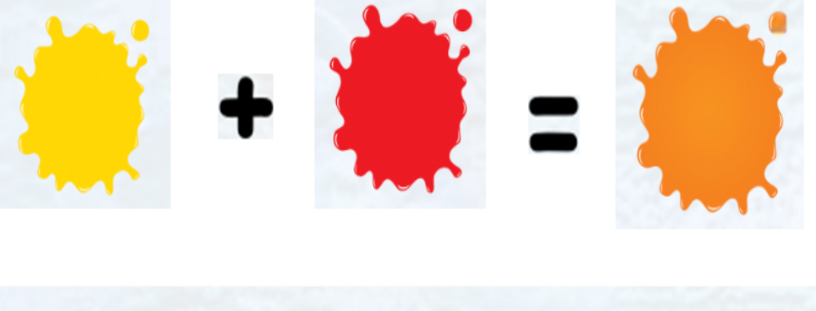
yellow
red
orange
……...and ……. make ……...
01
02
03
04
05
00

Slide 27

You are so lucky!

Slide 28
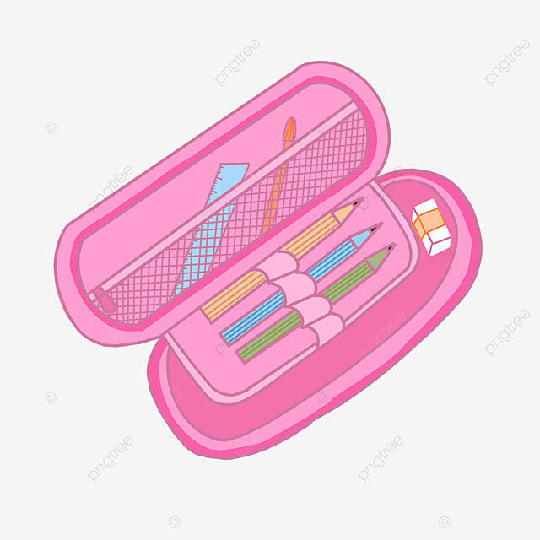
pink pencil case
I love my ………....……..…
01
02
03
04
05
00

Slide 29
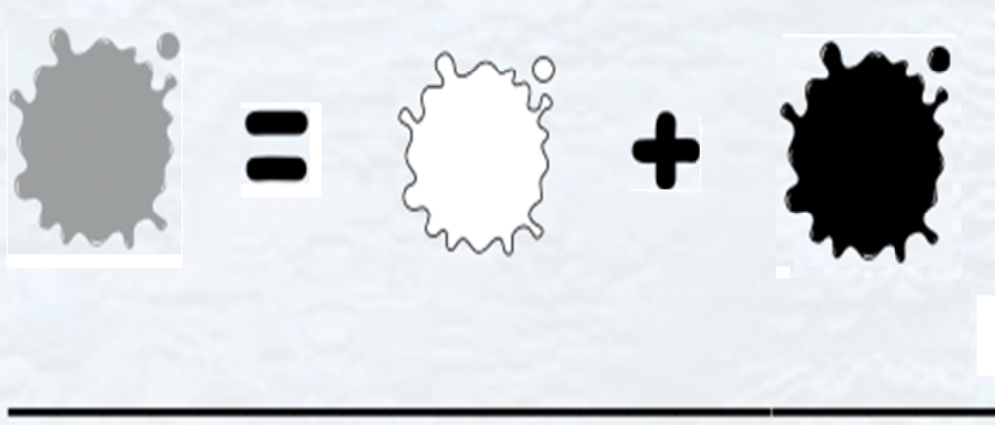
white
I can make gray with ……….... and ……..…
black
01
02
03
04
05
00

Slide 30

yellow notebook
I love my ………………………….
01
02
03
04
05
00

Slide 31
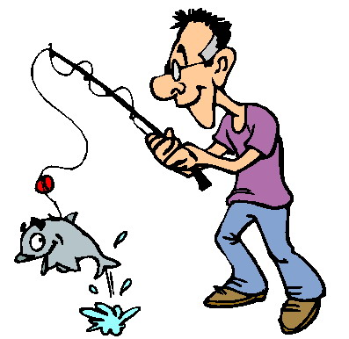
Well done!
One free point!

Slide 32

WRAP-UP

Slide 33
GOOD BYE!
Thank you!

