Slide 1

Unit 7: Toys
Lesson 1.1
Page 96

Slide 2
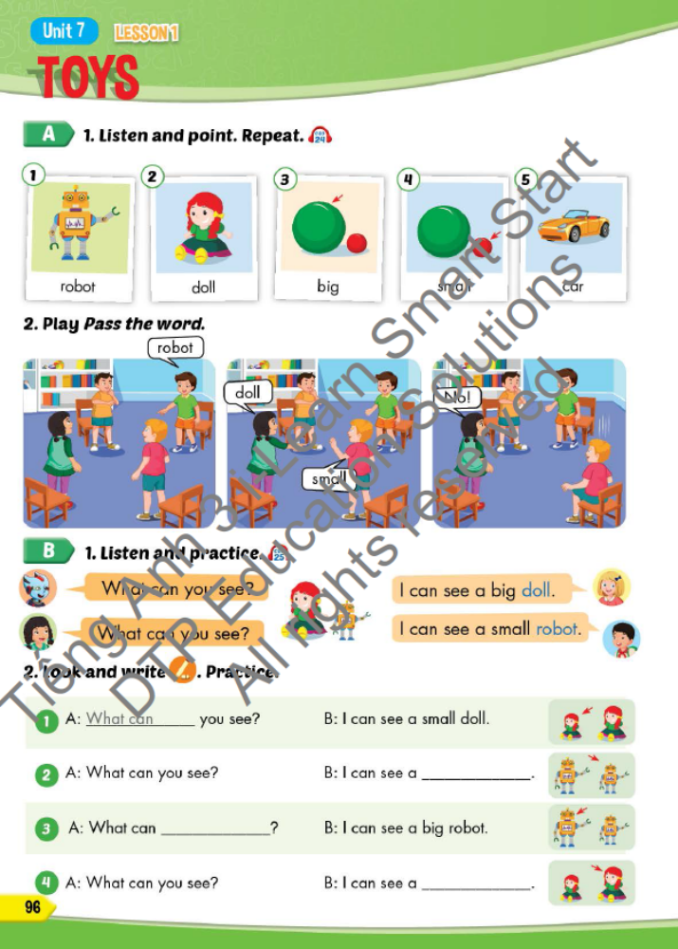
Lesson Outline
Warm-up
Vocabulary
Structure
Consolidation
Wrap-up

Slide 3
Objectives
By the end of this lesson, students will be able to…
Vocabulary: Pronounce and use the words related to the topic properly: robot, doll, big, small, car
Structure: Talk about what can they see by using:
What can you see? - I can see a big doll.
What can you see? - I can see a small robot.

Slide 4

WARM UP

Slide 5




robot
car

Slide 6


car
doll

Slide 7
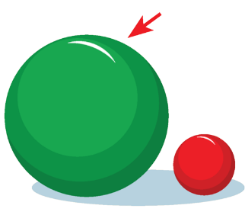
big
small

Slide 8
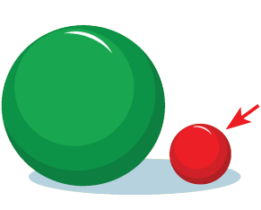
big
small

Slide 9

car
doll

Slide 10

It’s time to learn …

Slide 11
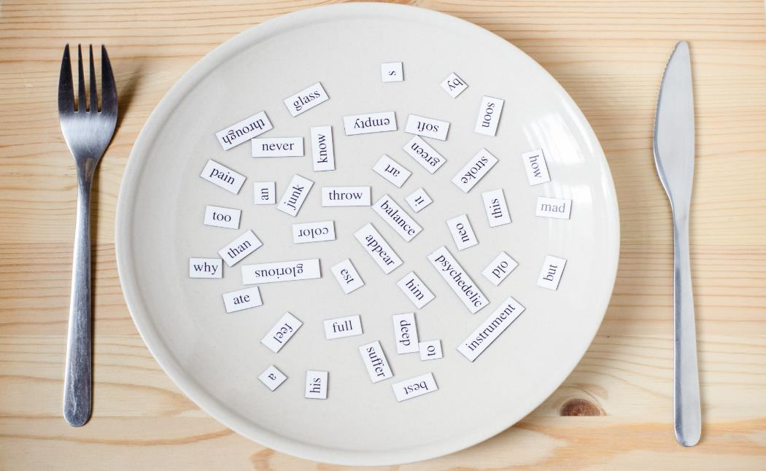
New words
robot
doll
big
small
car

Slide 12
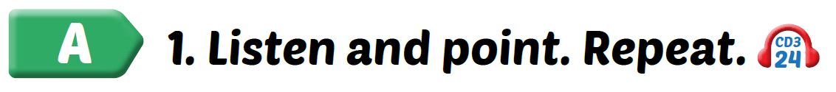
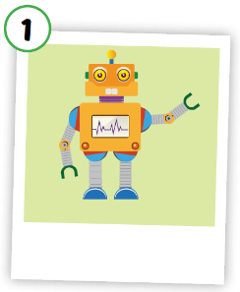
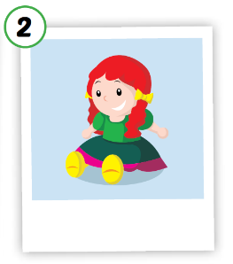
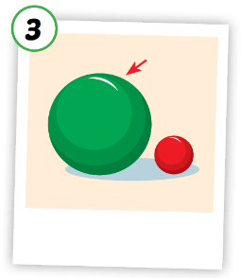
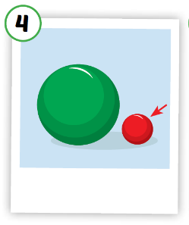
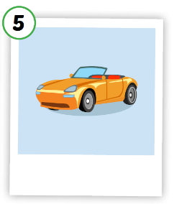





Click A to hear the sound
Notes:
Click vào hình A. 1. Listen and point. Repeat để cho cả audio full chạy

Slide 13
Click on each picture to hear the sound.
/dɑːl/
búp bê
/bɪɡ/
to, lớn
/smɑːl/
nhỏ, bé
/kɑːr/
ô tô, xe hơi
/ˈrəʊbɑːt/người máy
Notes:
Click vào hình A. 1. Listen and point. Repeat để cho cả audio full chạy

Slide 14

Click on each picture to hear the sound.
/ˈrəʊbɑːt/người máy
Notes:
Click vào hình A. 1. Listen and point. Repeat để cho cả audio full chạy

Slide 15

Click on each picture to hear the sound.
/dɑːl/
búp bê
Notes:
Click vào hình A. 1. Listen and point. Repeat để cho cả audio full chạy

Slide 16

Click on each picture to hear the sound.
/bɪɡ/
to, lớn
Notes:
Click vào hình A. 1. Listen and point. Repeat để cho cả audio full chạy

Slide 17

Click on each picture to hear the sound.
/smɑːl/
nhỏ, bé
Notes:
Click vào hình A. 1. Listen and point. Repeat để cho cả audio full chạy

Slide 18

Click on each picture to hear the sound.
/kɑːr/
ô tô, xe hơi
Notes:
Click vào hình A. 1. Listen and point. Repeat để cho cả audio full chạy

Slide 19
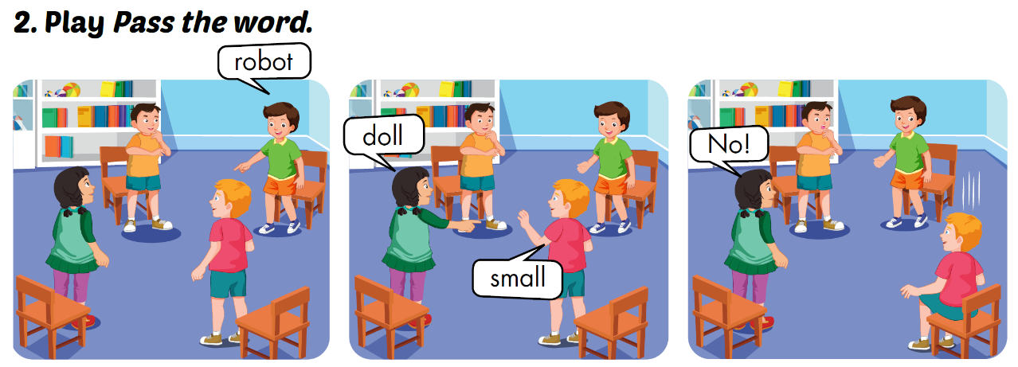

Slide 20





LOOK AND WRITE
b_g
i
_ar
c
t
robo_
d_ll
o
sm_ll
a

Slide 21
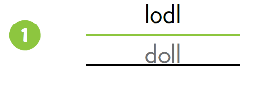
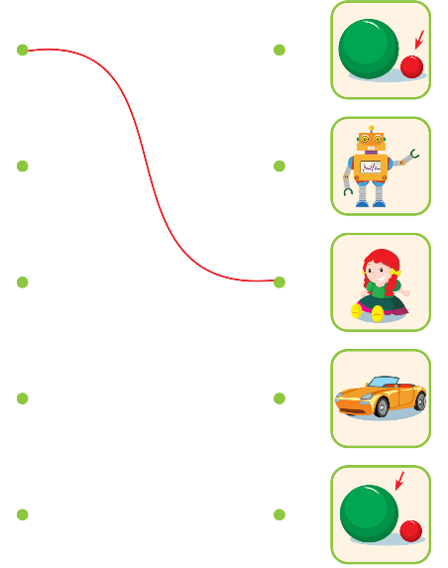
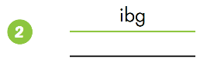
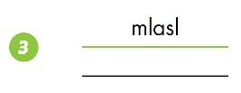
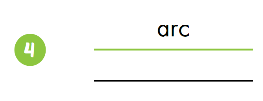
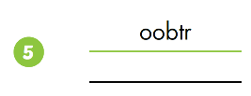
Extra Practice
WB, P. 68
big
small
car
robot

Slide 22
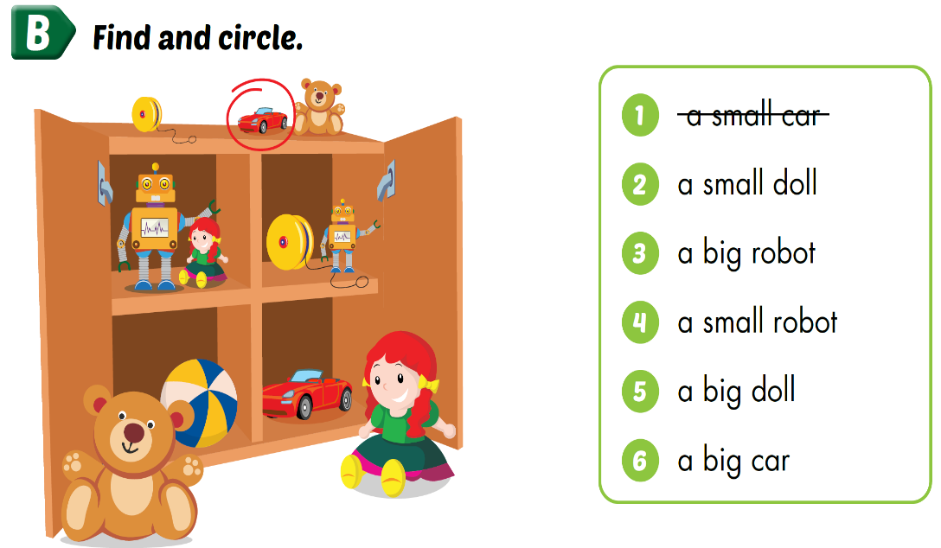
Extra Practice
WB, P. 68

Slide 23
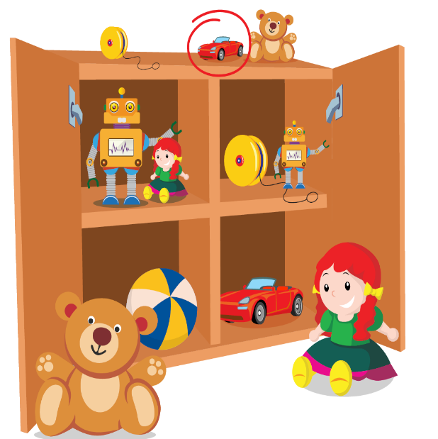

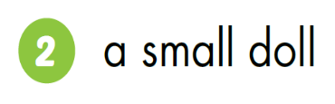
Extra Practice
WB, P. 68

Slide 24


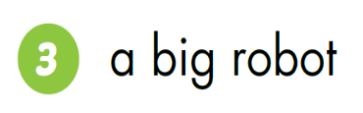
Extra Practice
WB, P. 68

Slide 25
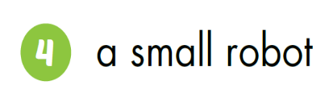
Extra Practice
WB, P. 68

Slide 26

Extra Practice
WB, P. 68

Slide 27
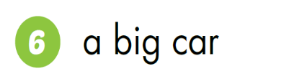
Extra Practice
WB, P. 68

Slide 28
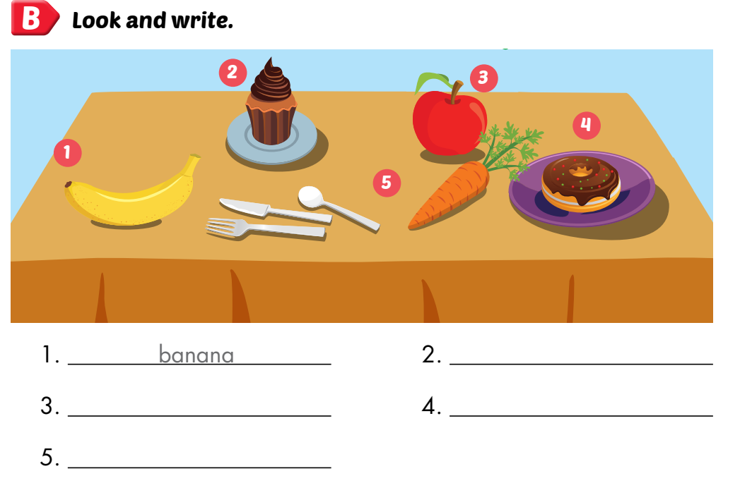
Extra Practice
WB, P. 78
cupcake
apple
donut
carrot

Slide 29
Structures
What can you see?
I can see a big doll.
What can you see?
I can see a small robot.

Slide 30

Presentation

Slide 31



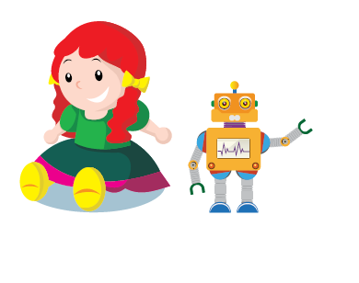

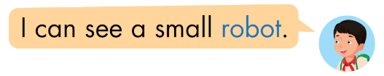

Slide 32

Practice

Slide 33


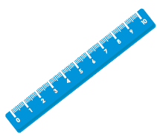

I can see a big ruler.

Slide 34


I can see a small robot.

Slide 35
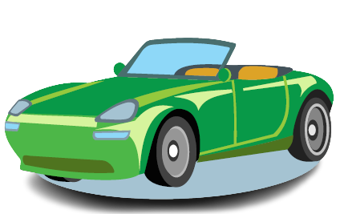

I can see a big car.

Slide 36


I can see a small doll.

Slide 37

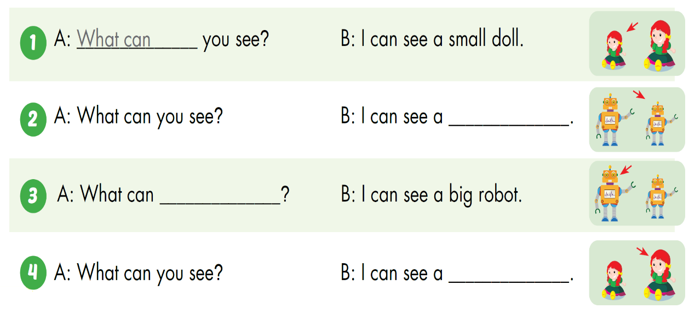
small robot
you see
big doll

Slide 38

CONSOLIDATION

Slide 39
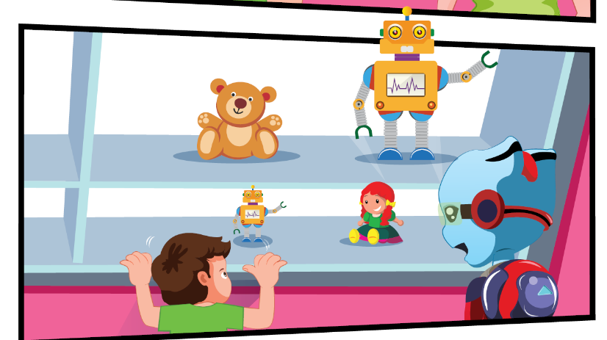
Describe the picture.

Slide 40

WRAP-UP

Slide 41
Unit 7: toys
New words
Doll
Robot
Car
Big
small
II. Structures
1. What can you see?
I can see a big doll.
2. What can you see?
I can see a small robot.

Slide 42
Homework
Practice vocabularies and structure. Make sentences using them.
Practice the vocabulary and structure in Tiếng Anh 3 i-Learn Smart Start Notebook (page 46)
Do the exercises in Tiếng Anh 3 i-Learn Smart Start Workbook (page 68)
Play the consolidation games in Tiếng Anh 3 i-Learn Smart Start DHA App on www.eduhome.com.vn
Prepare the next lesson (page 97)

Slide 43

Enjoy your day!

