Slide 1

Unit 1: My friends
Lesson 2.1
Page 13

Slide 2
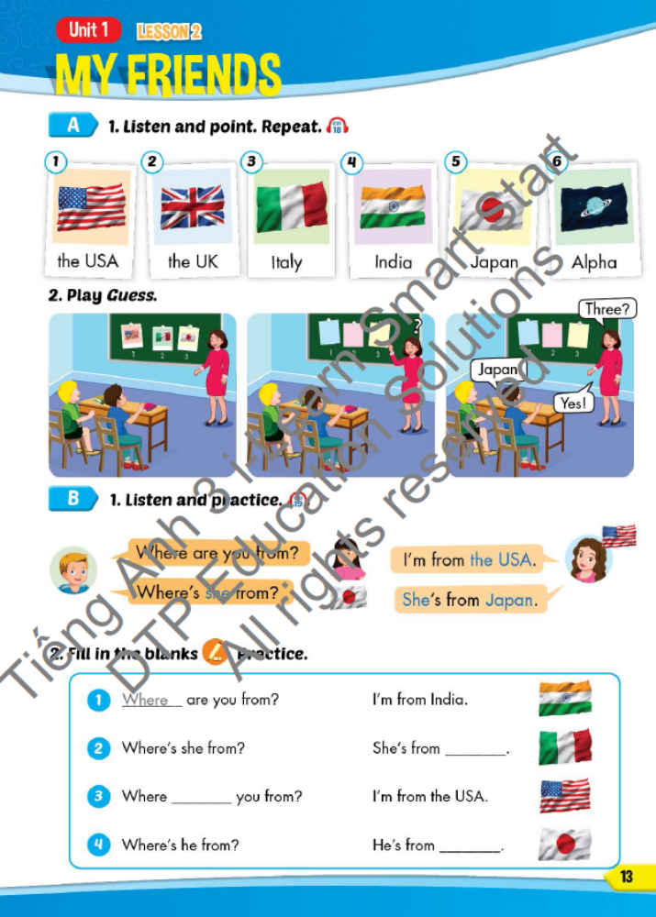
Lesson Outline
Warm-up
Vocabulary
Structure
Consolidation
Wrap-up

Slide 3
Objectives
By the end of this lesson, students will be able to use…
Vocabulary: The USA, The UK, Italy, India, Japan, Alpha
Structure: - Where are you from?
- I’m from the USA.
- Where’s she from?
- She’s from Japan.

Slide 4
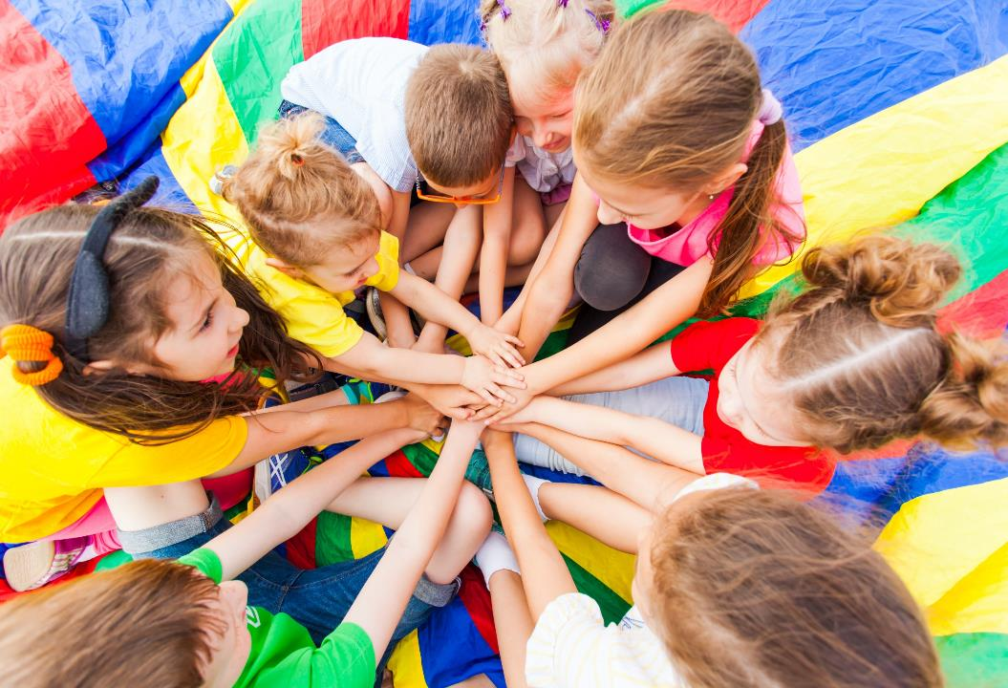
WARM UP
Notes:
UPPP (put hand on head)
Students sit in their chairs (if too many) or make a round (<20)
In turn count 1-2-UP-4-5-UP-7-8-UP-10-11-UP... (say UP instead of numbers 3,6,9,12,... which can divide 3)
Change the rule by saying UP instead of number which can DIVIDE 2;5;...
1-UP-3-UP-5-UP-7-UP...
1-2-3-4-UP-6-7-8-9-UP-11-12-13-14-UP...
(Students making mistake will be out of the round, the last one is the winner)

Slide 5
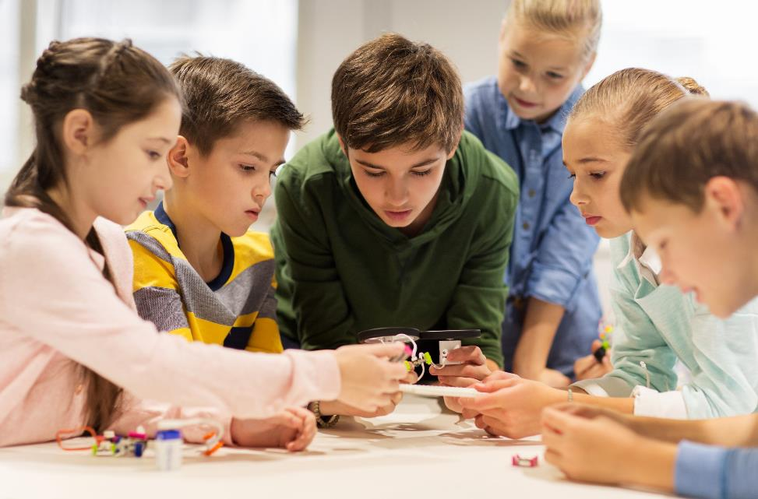
Up...
Notes:
UPPP (put hand on head)
Students make a round and sit down.
In turn count 1-2-UP-4-5-UP-7-8-UP-10-11-UP... (say UP instead of numbers 3,6,9,12,... which can divide 3)
(Students making mistake will be out of the round, the last one is the winner)
Change the rules by saying UP instead of number which can DIVIDE 2;5;...
1-UP-3-UP-5-UP-7-UP...
1-2-3-4-UP-6-7-8-9-UP-11-12-13-14-UP...

Slide 6

It’s time to learn …

Slide 7
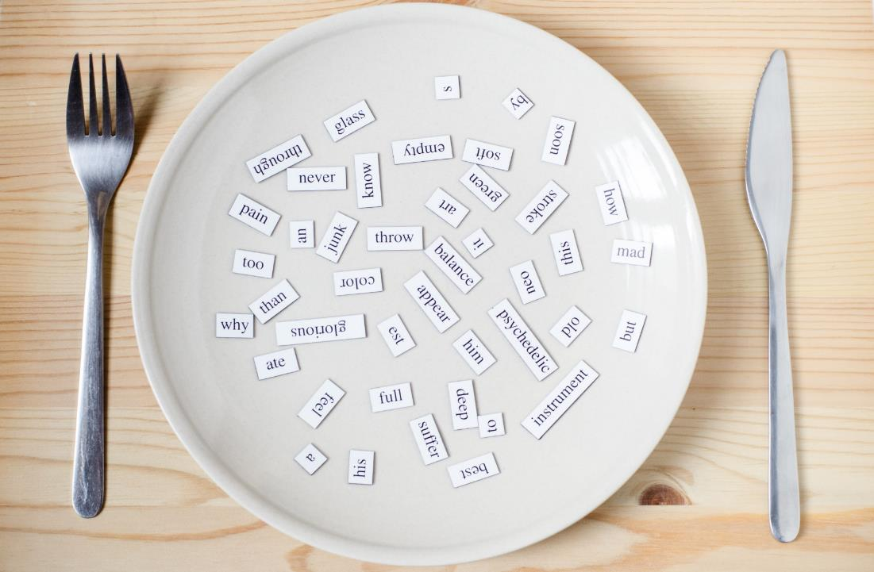
Vocab
the USA, the UK, Italy, India, Japan, Alpha

Slide 8

Presentation

Slide 9




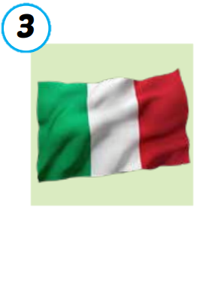
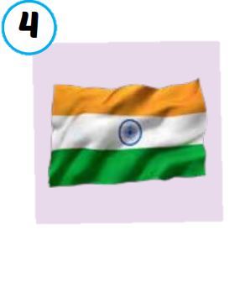

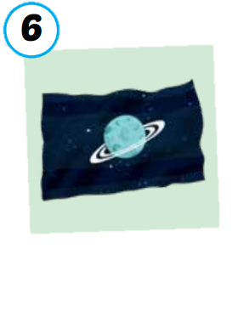
the USA
the UK
Italy
India
Japan
Alpha
/ðə ˌjuː es ˈeɪ/
nước Mỹ,
Hoa Kỳ
/ðə ˌjuː ˈkeɪ/
Vương quốc Anh
/ˈɪtəli/
nước Ý
/ˈɪndiə/
nước Ấn Độ
/dʒəˈpæn/
Nước Nhật
/ˈælfə/
Hành tinh Alpha

Slide 10

Practice 1

Slide 11






SLAP THE BOARD
Japan
The USA
The UK
Alpha
Italy
India
Notes:
Divide students into 2-3 groups. Make lines.
Teacher show picture one by one. One students of each team quickly SLAP THE BOARD and SAY ALOUD THE ANSWER at the same time.
The fastest and most correctly is the winner.
(there are 6 rounds)

Slide 12
Practice 2

Slide 13


Listen and match.
a
b
c
d
e
f
Notes:
Show listening option one by one.
Then show pictures and ask students to guess the answer.
Click on the STARS A/B/C/... To hear the sound.
Click on the background to reveal the line answers.

Slide 14

Extra practice

Slide 15
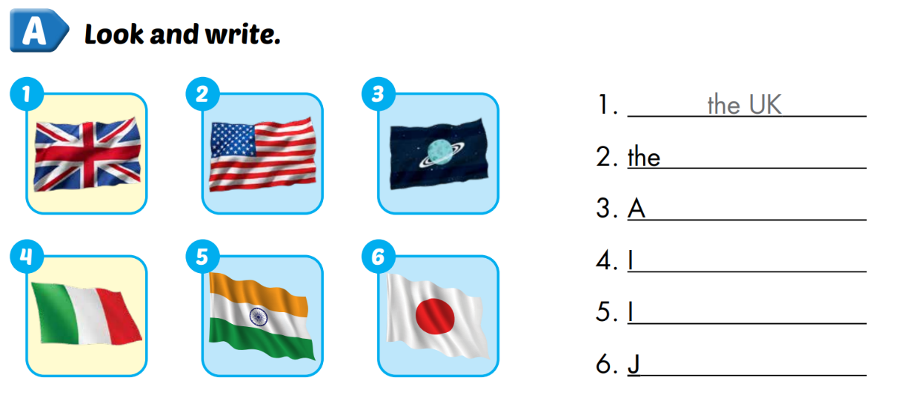
Extra 1 – WB P.10
USA
lpha
taly
ndia
apan

Slide 16
Structure
Where are you from?
I’m from ...

Slide 17
Presentation

Slide 18








Notes:
Click on each sentence to hear the sound.
Click on the headphone CD1 19 to hear the entire audio.

Slide 19
Practice 1

Slide 20

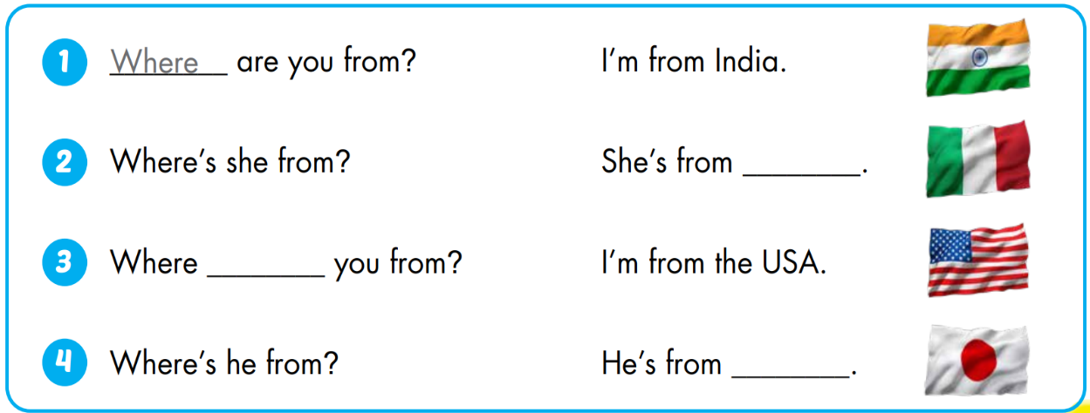
Italy
are
Japan

Slide 21
Practice 2

Slide 22















2
4
WHEEL OF POINT
3
6
1
5
֎
3
6
4
5
2
1
Where are you from?
I’m from ...
Where is he from?
He’s from ...
Where is she from?
She’s from ...
Notes:
Divide students into 2 teams. Tiktoktoe to find the winner, the loser asks, the winner answers.
The winner SPIN THE WHEEL to get points. (click on the arrow to move to the wheel)
(there are 12 rounds)
Click on the wheel to go to WHEEL SLIDE

Slide 23


30
20
40
10
50
80
60
70
SPIN
Notes:
- Click SPIN to spin the wheel, CLICK the wheel to STOP, CLICK HOUSE to RETURN

Slide 24
Extra practice

Slide 25
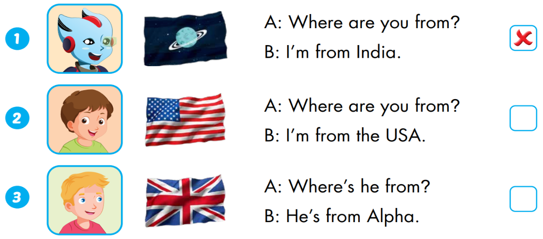


Extra 1 – WB P.10
Alpha
the UK

Slide 26

CONSOLIDATION

Slide 27
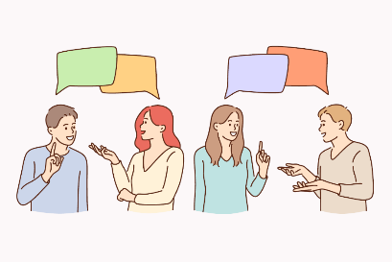
Sarah: Hello. What’s your name?
Dylan: Hi. My name’s Dylan.
Sarah: How can you spell “Dylan”?
Dylan: It’s D-Y-L-A-N. What’s your name?
Sarah: My name’s Sarah.
Dylan: How can your spell “Sarah”?
Sarah: It’s S-A-R-A-H.
Dylan: Where are your from?
Sarah: I’m from the USA. What about you?
Dylan: I’m from Italy. Nice to meet you.
Sarah: Nice to meet you, too.
Dylan: My friend’s name is Alfie.
Sarah: Where is he from?
Dylan: He’s from Alpha.
Play roles. Make the similar conversation.
Notes:
- Work in pairs, play roles and make the similar conversation.

Slide 28

WRAP-UP

Slide 29
Today’s lesson
Vocabularies
The USA, the UK, India, Italy, Japan, Alpha
Structures/ Sentence patterns
Where are you from?
I’m from ... .
Where is she/he from?
She’s/He’s from ... .

Slide 30
Lesson 3
Homework
Practice the vocabularies and structure; and make sentences using them.
Do the exercises in Tiếng Anh 3 i-Learn Smart Start WB (page 10)
Do the exercises in Tiếng Anh 3 i-Learn Smart Start Notebook (page 11)
Prepare the next lesson (page 14 SB)

Slide 31

Enjoy your day!

