Slide 1
Unit 8
What are
you reading?
Lesson 1

Slide 2
VOCABULARY

Slide 3
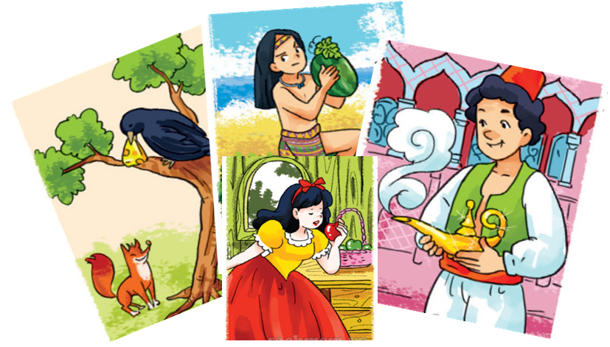

A. Vocabulary.
fairy tale
/ˈferi teɪl/
truyện cổ tích

Slide 4
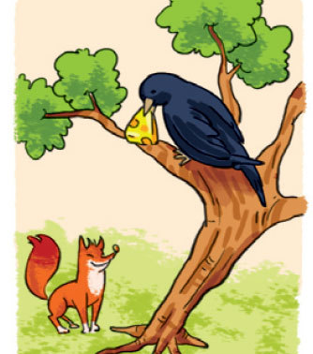
A. Vocabulary.
The Fox and the Crow /ðə fɒks ænd ðə krəʊ/
con Cáo và con Quạ

Slide 5
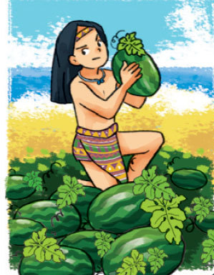
A. Vocabulary.
The Story of Mai An Tiem
/ðə ˈstɔːri ɒv Mai An Tiem/
câu chuyện Mai An Tiêm

Slide 6
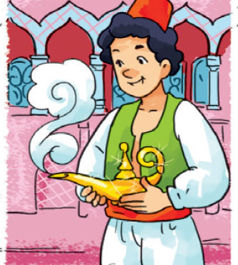
A. Vocabulary.
Aladdin and the Magic Lamp
/əˌlæd.ɪnz ænd ðə ˈmæʤɪk læmp/
Aladdin và cây đèn thần

Slide 7
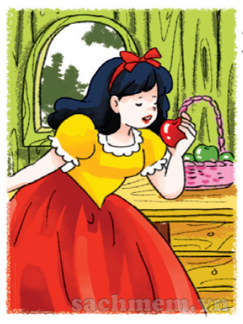
A. Vocabulary.
Snow White and
the Seven Dwarfs
/snəʊ waɪt ænd ðə ˈsevən dwɔːfs/
Nàng Bạch Tuyết và bảy chú lùn

Slide 8
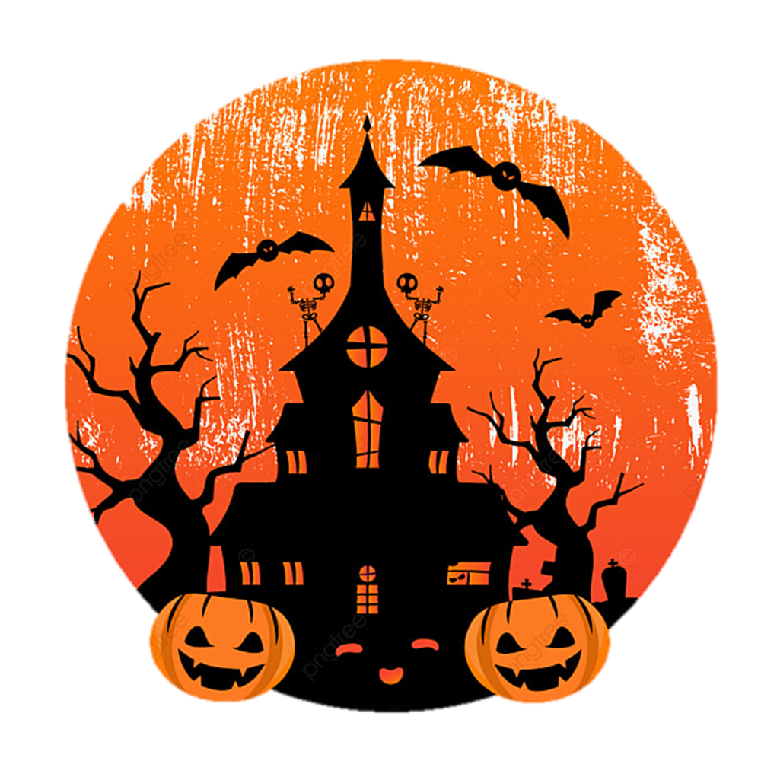
A. Vocabulary.
Halloween
/ˌhæləʊˈiːn/
lễ hội hóa trang

Slide 9
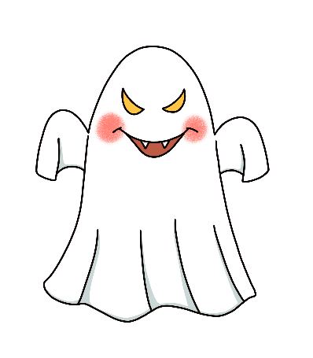
A. Vocabulary.
ghost
/ɡəʊst/
con ma

Slide 10
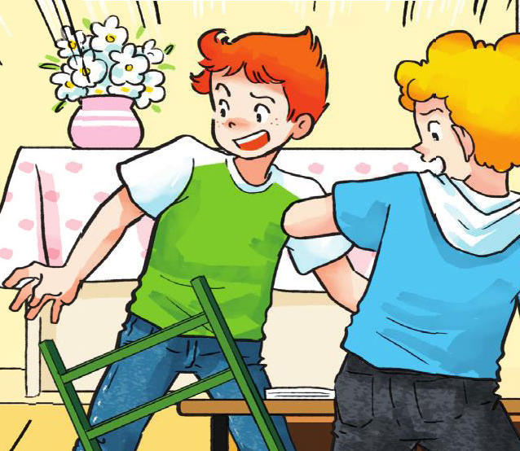
A. Vocabulary.
scare
/sker/
sợ

Slide 11
A. Vocabulary.
Aladdin and
the Magic Lamp
(Aladdin và cây đèn thần)
Snow White and
the Seven Dwarfs
(Nàng Bạch Tuyết
và bảy chú lùn)
fairy tale
(truyện cổ tích)
The Story of Mai An Tiem
(câu chuyện
Mai An Tiêm)
The Fox and the Crow
(con Cáo và con Quạ)
Halloween
(lễ hội hóa trang)
ghost
(con ma)
scare
(sợ)

Slide 12
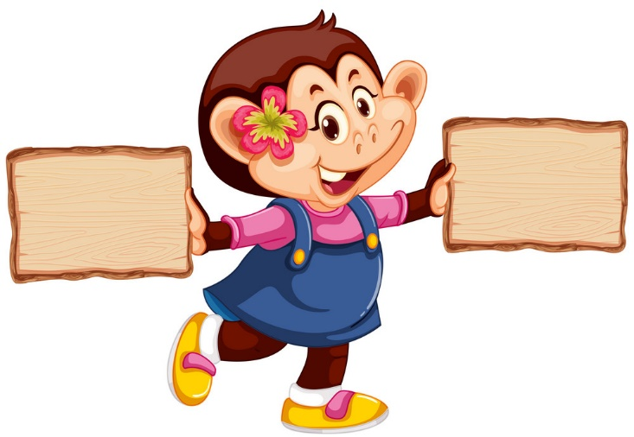
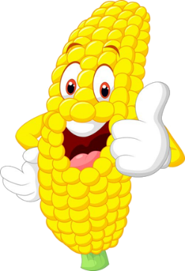
right
left

Slide 13
Snow White and the Seven Dwarfs
The Fox and the Crow

Slide 14
The Story of Mai An Tiem
The Fox and the Crow

Slide 15
Halloween
fairy tale

Slide 16
The Story of Mai An Tiem
Aladdin and the Magic Lamp

Slide 17
Snow White and the Seven Dwarfs
The Fox and the Crow

Slide 18
ghost
scare

Slide 19
ghost
Halloween

Slide 20
scare
fairy tale

Slide 21
GRAMMAR

Slide 22

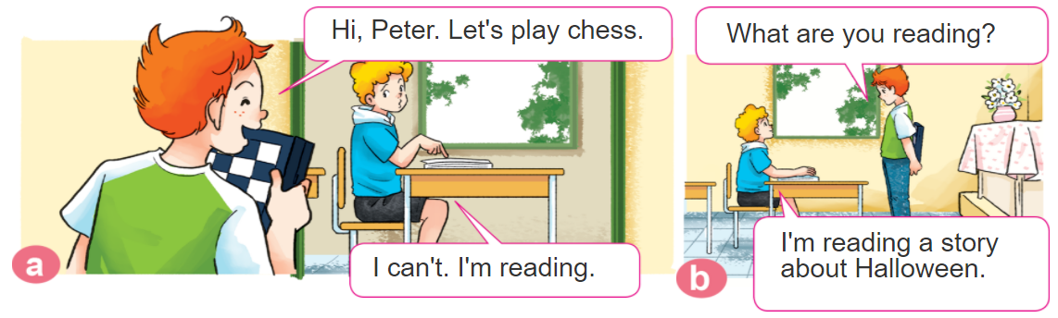
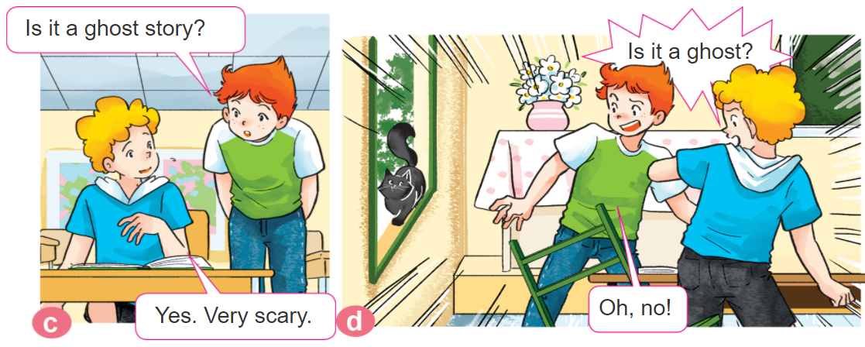
1. Look, listen and repeat.

Slide 23
New words:
B. Grammar
Hỏi và đáp bạn mình đang đọc gì:
- What are you reading?
I’m reading + tên truyện/tên sách
fairy tale truyện cổ tích | The Story of Mai An Tiem câu chuyện Mai An Tiêm
halloween lễ hội hóa trang | Aladdin and the Magic Lamp Aladdin và cây đèn thần
ghost con ma | Snow White and the Seven Dwarfs Nàng Bạch Tuyết và bảy chú lùn)
scare sợ | The Fox and the Crow con Cáo và con Quạ

Slide 24
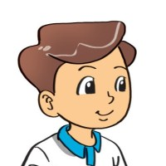
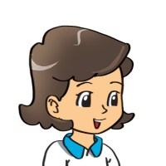
2. Point and say.
What are you reading?
I'm reading ______.
Snow White and the Seven Dwarfs
The Fox and the Crow
The Story of Mai An Tiem
Aladdin and the Magic Lamp

Slide 25

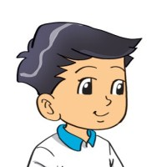
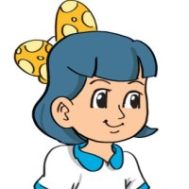


3. Let’s talk.
Ask and answer questions about the book/story you are reading.
Do you read books in your free time?
Yes, I do.
/ No, I don’t.
What are you reading now?
I'm reading ______.
What's your favourite book/story?
It's ________.

Slide 26


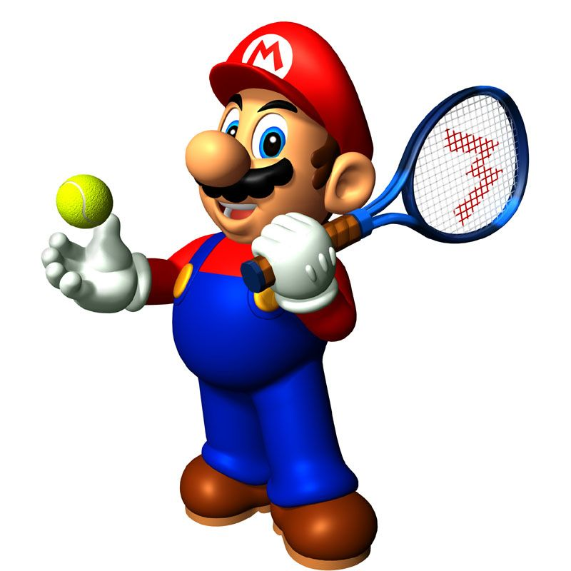





Slide 27
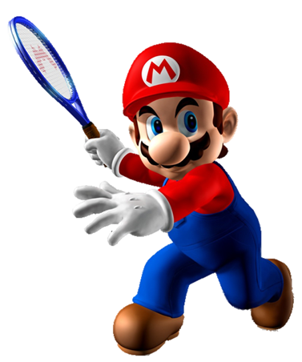
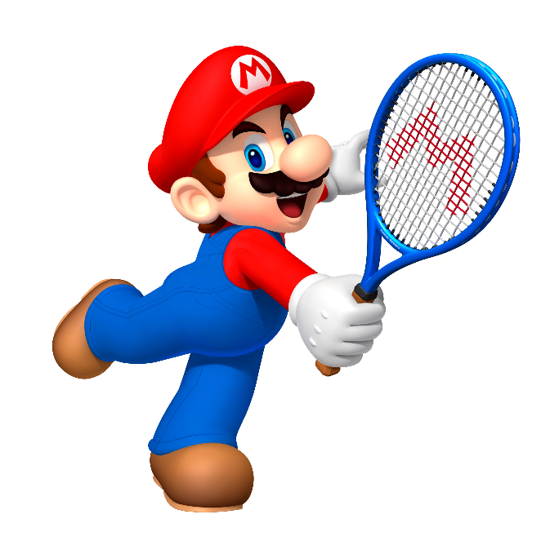


I’m reading The Fox and the Crow.
I’m reading The Story of Mai An Tiem.
What are you reading?
I’m reading Snow White and the Seven Dwarfs.

Slide 28
I’m reading The Story of Mai An Tiem.
I’m reading Aladdin and the Magic Lamp.
What are you reading?
I’m reading The Fox and the Crow.

Slide 29
I’m reading The Story of Mai An Tiem.
I’m reading The Fox and the Crow.
What are you reading?
I’m reading Snow White and the Seven Dwarfs.

Slide 30
I’m reading Aladdin and the Magic Lamp.
I’m reading Snow White and the Seven Dwarfs.
What are you reading?
I’m reading The Fox and the Crow.

Slide 31
I’m reading The Fox and the Crow.
I’m reading Aladdin and the Magic Lamp.
What are you reading?
I’m reading fairy tales.

Slide 32
It’s Snow White and the Seven Dwarfs
What's your favourite story?
I’m reading Snow White and the Seven Dwarfs
I wants

Slide 33
I’m reading Aladdin and the Magic Lamp
What's your favourite story?
It’s Aladdin and the Magic Lamp.
Intelligent

Slide 34
Next
I’m reading The Story of Mai An Tiem.
What's your favourite story?
It’s The Story of Mai An Tiem.

Slide 35
It’s The Fox and the Crow.
What's your favourite story?
I’m reading The Fox and the Crow.
do

Slide 36
Thank you

Slide 37

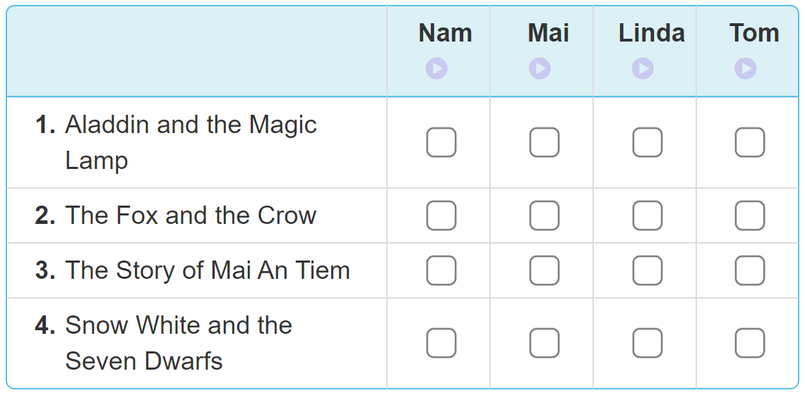
4. Listen and tick
✔
✔
✔
✔

Slide 38
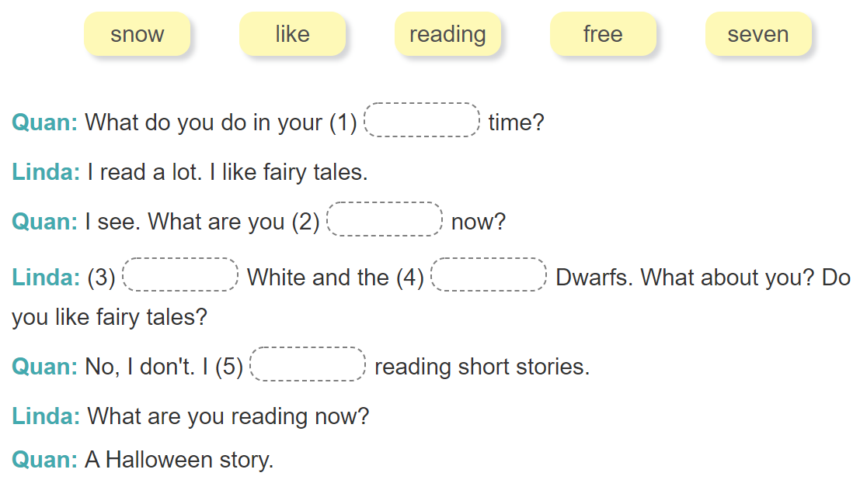
5. Read and complete
free
reading
Snow
seven
like

Slide 39
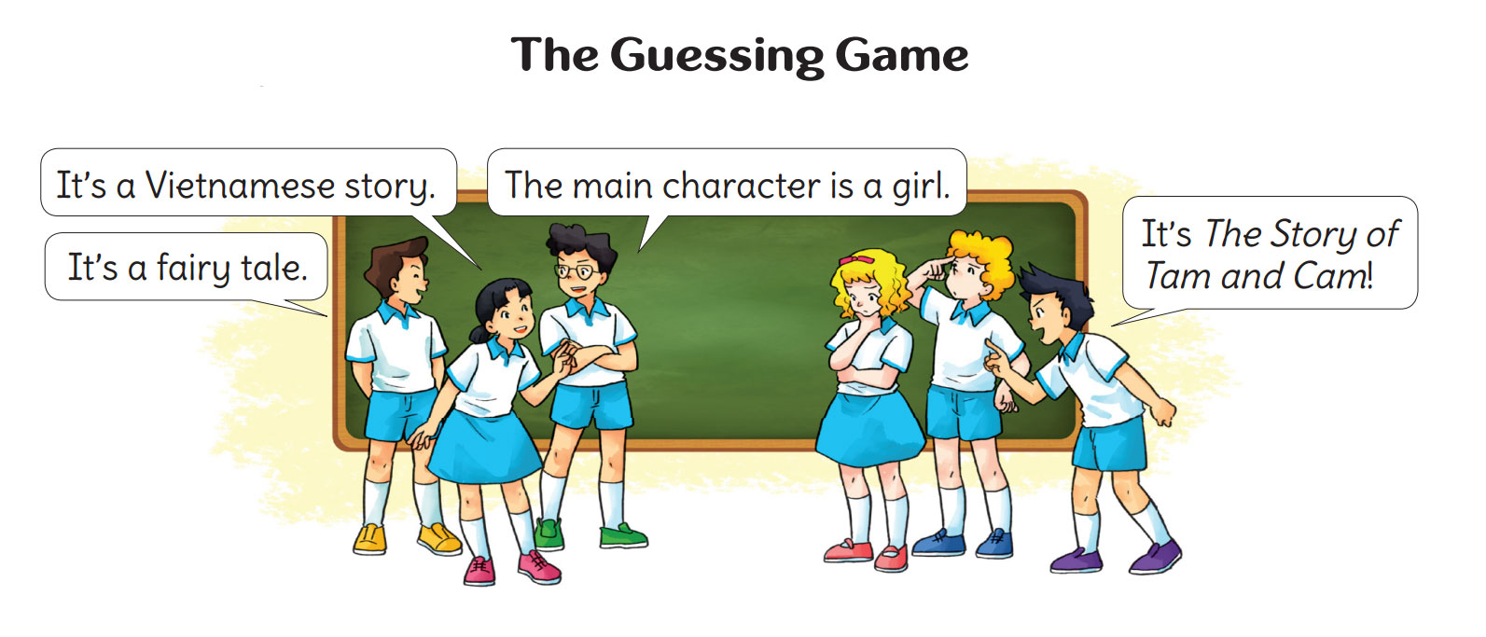
6. Let’s play.

